Slide 1
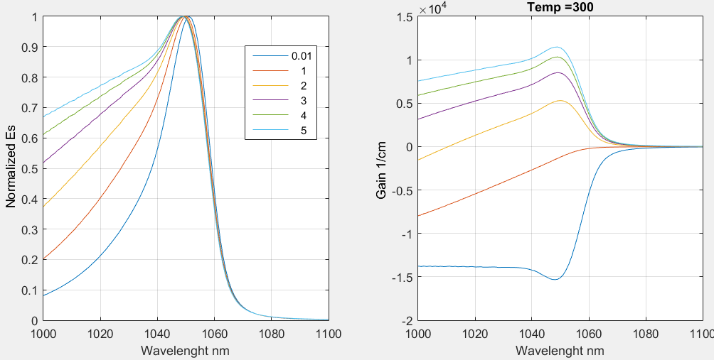


ShowResultsSpecDic19
Notes:
AndersDic19

Slide 2



ShowResultsDensDic19
Notes:
AndersDic16DensLam

Slide 3



ShowResultsSpecDic19Alpha
Notes:
AndersDic16LamDens

Slide 4



ShowResultsSpecDic19Ren
WITH BGRen from here
Notes:
AndersDic19ren

Slide 5



ShowResultsDensDic19Ren
Notes:
AndersDic19DensLamRen

Slide 6



ShowResultsSpecDic19AlphaRen
Notes:
AndersDic16LamDensRen

Slide 7



WITH x10 kgrid from here (from 450 to 4500 point)
ShowEwa1
Notes:
Ewa1

Slide 8



ShowEwa2
Notes:
AndersDic16LamDensRen

